Slide 1
Rope Making, Whipping, and Splicing
Terry McKibben
Assistant Scoutmaster
BSA Troop 344/9344
Pemberville, OH
troop344leaders@gmail.com

Slide 2

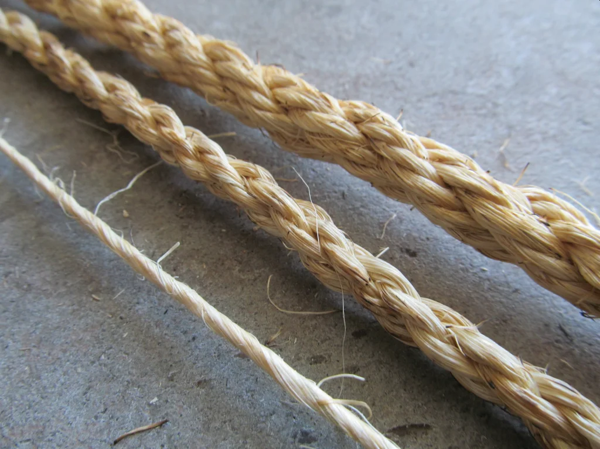
Making Rope
Need to get your Scouts excited about tying knots, whipping rope, and splicing? Why not make their own individual pieces of rope to practice with?
With a few simple materials and supplies, you can make just about any size or color rope you want.

Slide 3
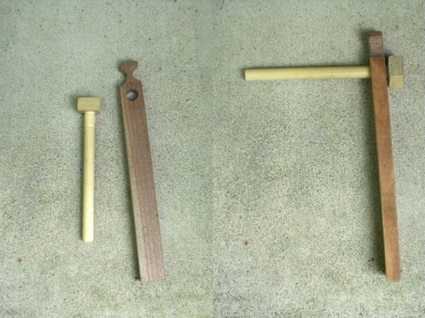
Making Rope with a Pendulum Spinner
Step 1: Build the Spinner
Materials and Construction of the Pendulum Spinner:
  1/2" diameter dowel, 8" long.
  1” x 1” x ¾” piece of wood with a 1/2" hole drilled in the center.
  Place it at the end of the dowel and glue and nail it in place (predrill the nail hole so the block does not split).
  1 1/4" x 3/4" x 12" piece of wood with a 3/4" diameter hole drilled and a notch cut as shown.
  With a file or sandpaper, round off any sharp edges within the notch.
Anchor Stick:
  1” diameter dowel (or broomstick) 12” long.

Slide 4
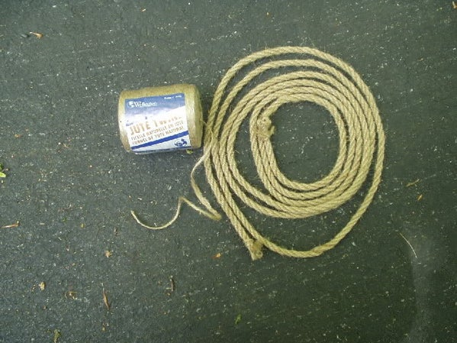
Making Rope with a Pendulum Spinner
Step 2: Cut the Twine
You will need to cut an 80’ length of sisal binder twine to make an approximately 8’ long piece of rope.

Slide 5
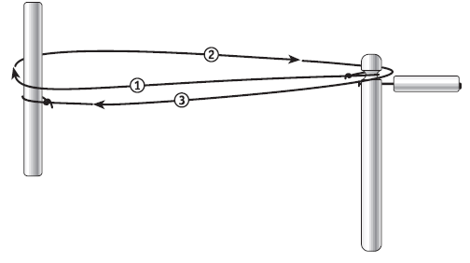
Making Rope with a Rope Spinner
Step 3: Setup
Attach one twine end to the notch of the spinner and the other to the anchor stick using a bowline knot or another loop knot.
Make the loop large enough to slip off the spinner when you are finished or else you will need to cut it off.
Loop the twine as shown in the illustration below.
Three strands of twine make a nice lashing rope (about 1/4” to 5/16” in diameter) but you can add more for larger diameter rope.

Slide 6
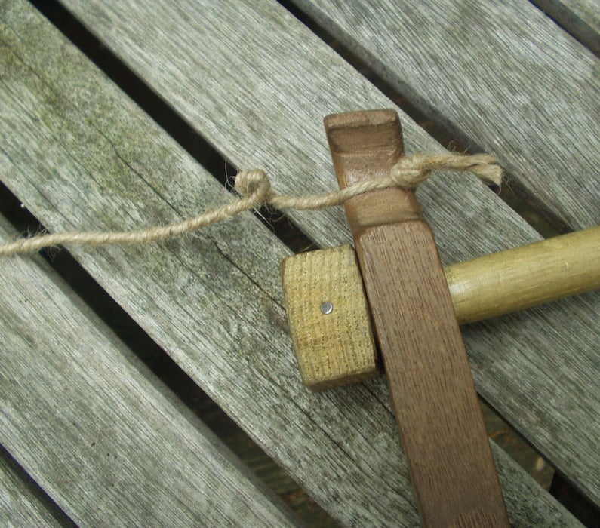
Making Rope with a Rope Spinner
It is quicker to make a rope with a pair of Scouts when each uses a Spinner.
Step 4: First Spin (Using Two Spinners)
Maintaining tension between the two ends, each Scout will move the hand holding the dowel in a clockwise direction.
This will cause the pendulum to rotate around the handle imparting a twist to the strands.
Occasionally stop and have the Scouts do a little “Tug-of-War” to help set the twist.
Continue turning until a kink develops when you release the tension between the two ends.
If using one spinner and an anchor stick, only one Scout will be spinning.
Caution the Scouts to be careful doing the twisting because it can really hurt if the spinning block of wood hits them when they are twisting the strands

Slide 7
Making Rope with a Rope Spinner
Step 5: Triple the Strands (Using Two Spinners)
Once the strand is tightly spun, it must be “tripled” or “Z-bent” to make rope.
This is the tricky part for youngsters or even first-time adults, since the individual segments must be kept tight at all times to prevent kinks.
With two additional helpers placed at “thirds” on opposite sides of the strand, have each back up while holding his segment (see diagram on next slide).
These bends are then looped over the notch of each spinner, making the rope one-third its original length.
(This can be done with only two people by looping the strand over something like a trailer hitch ball or a sturdy fence post.)

Slide 8
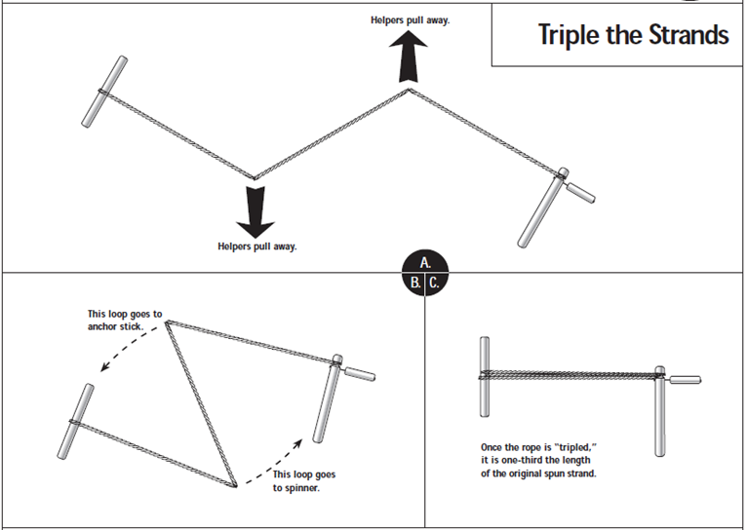
Making Rope with a Rope Spinner

Slide 9
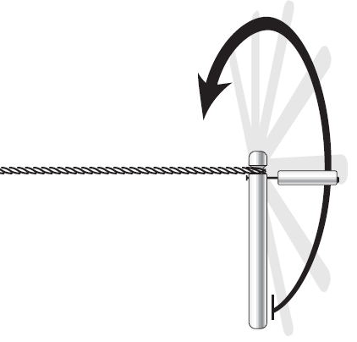
Making Rope with a Rope Spinner
Step 6: Second Spin (Using Two Spinners)
Stretch the three strands until they are even lengths. While keeping tension on the now tripled twisted strands, the two Scouts holding the rope spinners begin moving their spinners in a counter-clockwise direction.
They might need to push the wooden spinner with their free hand to get it going during this phase.
Continue spinning, in the opposite direction (counterclockwise) until tight
If only using one spinner, the Scout holding the anchor stick is responsible for keeping the twisting strands taut.
Overtighten this spin (a kink develops when you release the tension between the two ends) and do a quick tug-of-war to “set” the rope.

Slide 10
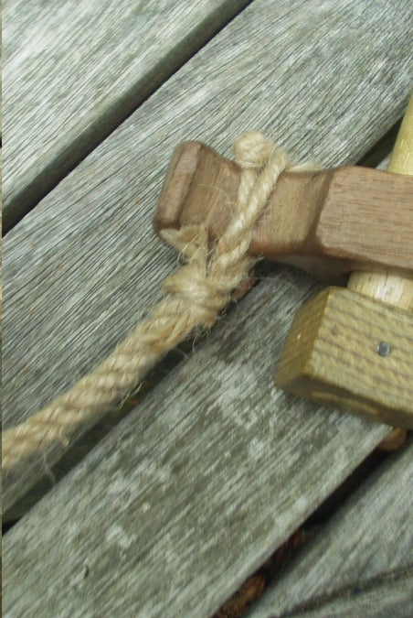
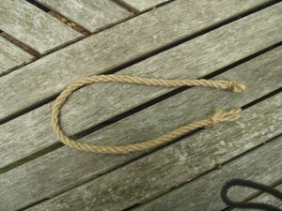
Making Rope with a Rope Spinner
Step 7: Finish
Tie a constrictor knot at each end to prevent unravelling and then cut or remove the ends off of each notch.
Making rope by this method is easy, but it takes up a lot of room.
The 80' piece of twine requires 27’ of space between the rope spinners for the initial twisting (before looping) and ultimately will make about 8’ of rope.
If you would prefer a 6’ piece of rope, you will need 60’ of twine and 20’ of space between the rope clubs for the initial twisting.
  The finished rope will be about 1/10 of the initial length of twine.

Slide 11
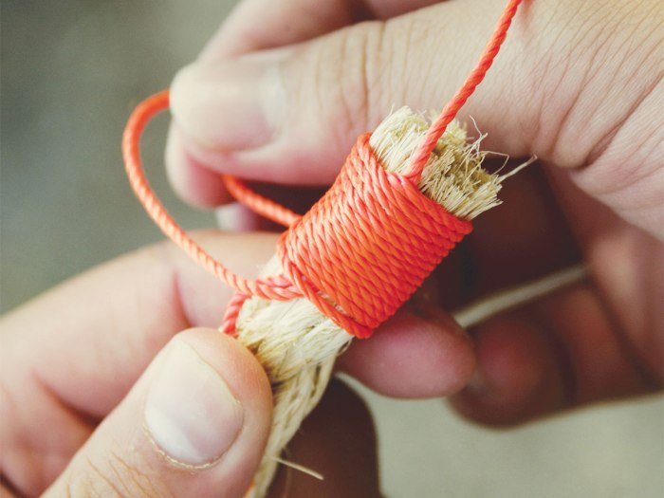
Whip the Ends of the Rope
Whip both ends of the rope before removing the constrictor knots unless you are splicing one end.
Materials:
  Newly made rope.
  At least 10 inches of waxed string.
  Scissors.

Slide 12
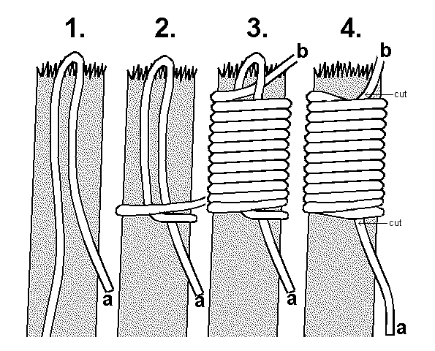
How to Whip the Ends of a Rope
Cut a piece of waxed string at least 8-10 inches long.
Make a loop and place it on one end of the rope as shown in the illustration to the left.
Wrap the string tightly around the rope several times.
When the whipping (wrapped string) is as wide as the rope is thick, slip the end through the loop.
Pull the string ends tightly until the loop just disappears under the wraps.
Cut the ends of the waxed string off.
Trim the end of the rope that was unraveling.

Slide 13
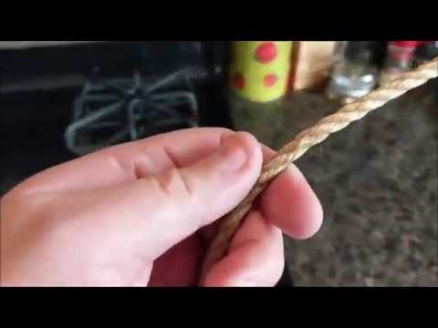
Singeing a Rope
Step 9
Run the rope, from one end to the next, quickly through a flame to singe off any stray fibers that are sticking out.
Watch the YouTube video for the technique.

Slide 14
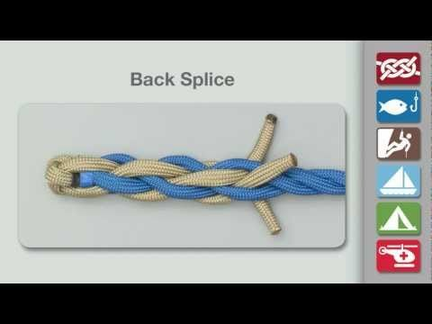
Back Splice
The back splice is made to prevent the end of the rope from raveling.
  It can be used instead of making a whipping.
Of the three splices shown here, the back splice is the least used because its bulk at the working end of the rope makes tying some knots more difficult.
Watch the YouTube video on how to do a back splice.

Slide 15
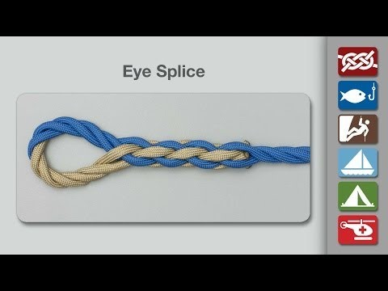
Eye Splice
The eye splice creates a fixed loop at the end of the rope.
Watch the YouTube video on how to do an eye splice.

Slide 16
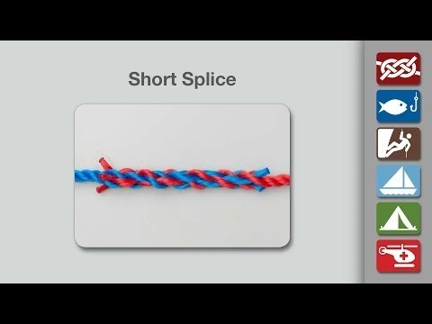
Short Splice
A short splice can be used in place of a knot to join two ropes or the ends of the same rope together.
If two ropes are being joined with a short splice, they should be the same type of rope and have the same diameter.
Watch the YouTube video on how to do a short splice.

